Slide 1
Autonomous Driving
By Crystal Hess
http://csed.fun

Slide 2
Learning Goals
How is programming for a controlled environment different than programming for an uncontrolled one?
Use knowledge from previous units (methods, variables, loops, etc) to create programs that drive Edison

Slide 3
How is programming for a controlled environment different than programming for an uncontrolled one?

Slide 4
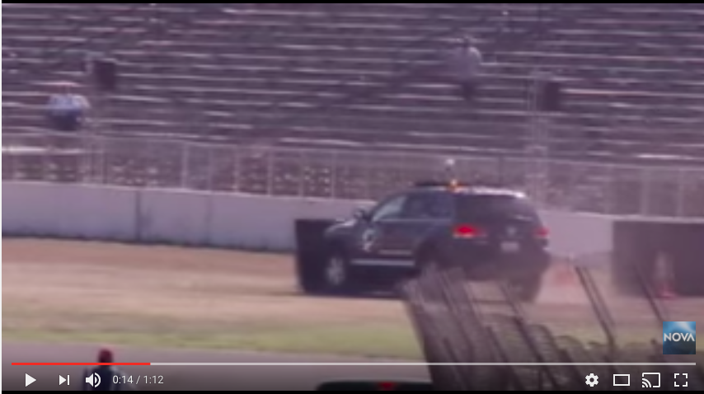
DARPA Grand Challenge
https://www.youtube.com/watch?v=xs7aOfrn6PA

Slide 5
External Influences for Edison
Lines on the ground
Obstacles
Other Edisons (IR Sounds)
Light

